Slide 1
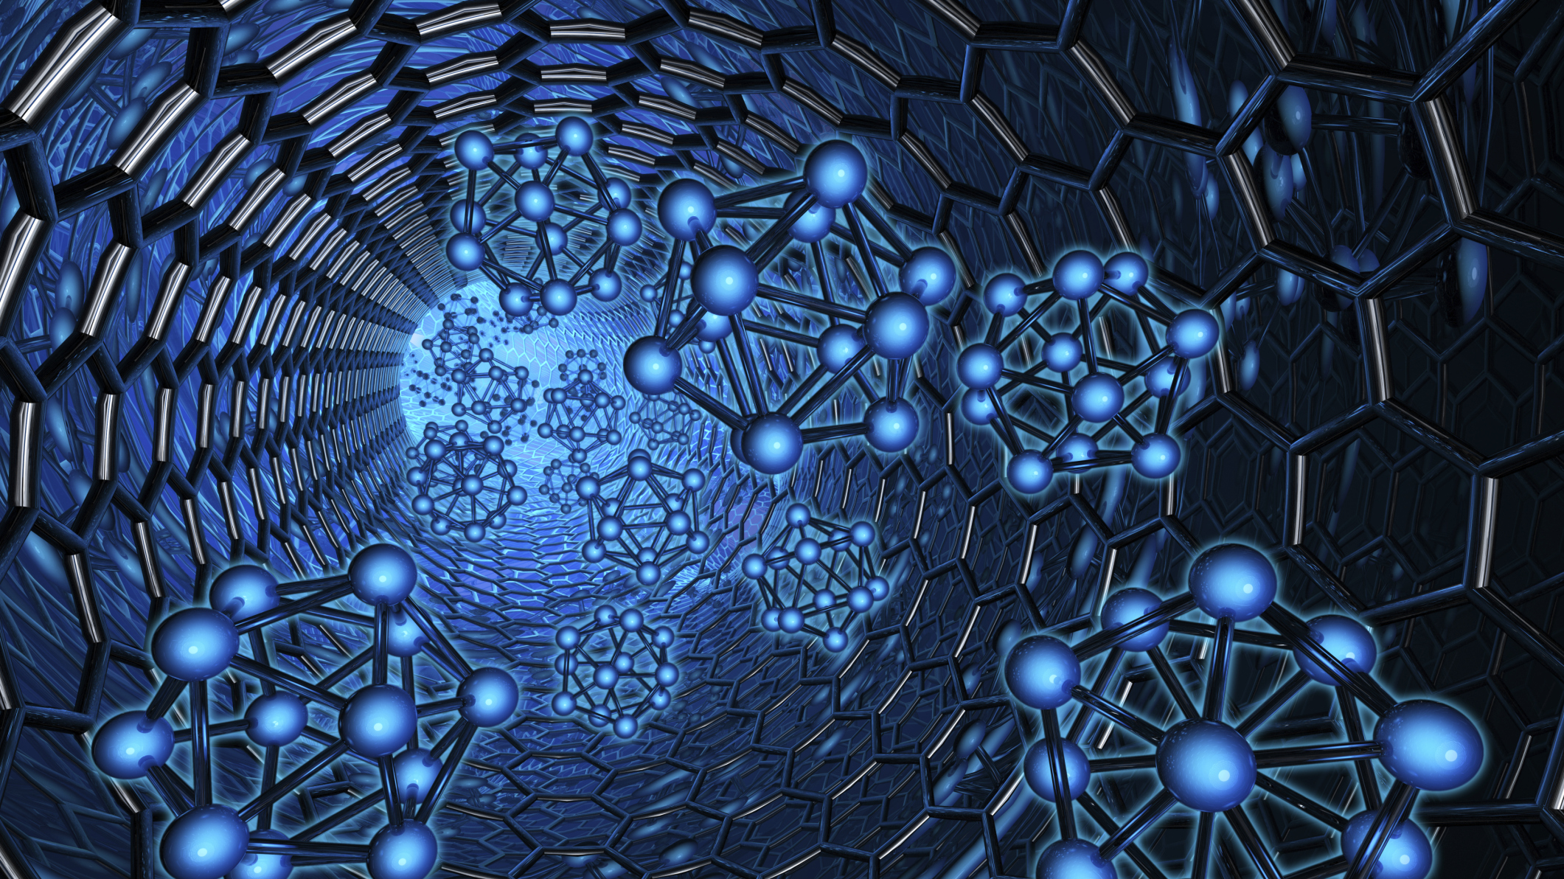
Sensbit
By
Krishnan M

Slide 2


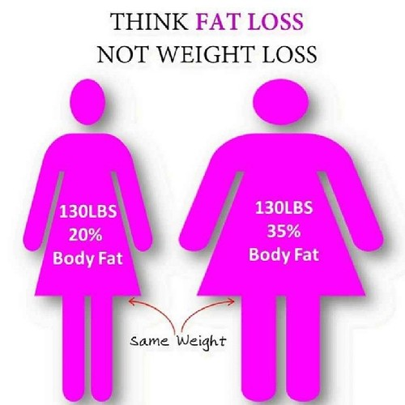
Weight loss Vs Fat loss

Slide 3
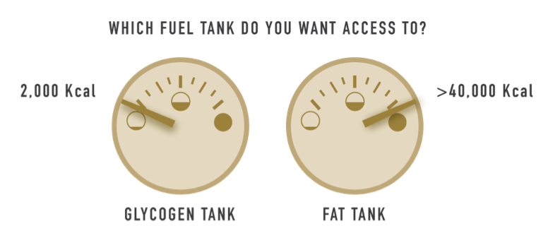
Fueling mechanism of the body

Slide 4
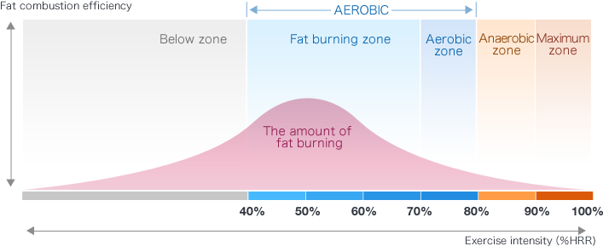
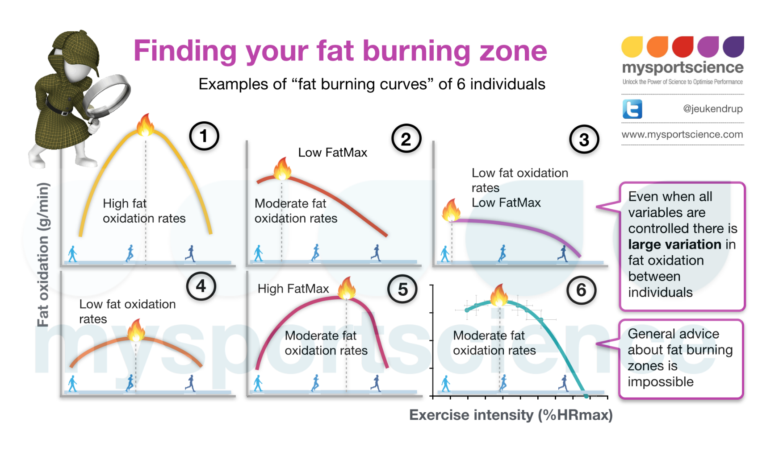
Fitness trackers
Calorie count-30% error
Idle fat burning rate
No insight to what is happening inside the body

Slide 5
SENSBIT
Wearable device-Nano-bio sensor-patch, band or watch
Analyse skin emanates
Device that can track the amount of fat burned
Helps to stay in optimum fat burn phase
Keeps real track of the effectiveness
If the activity or life style is helpful
Instantaneous fat burning rate
Insight into body fuelling mechanism
device-Nano-bio sensor

Slide 6
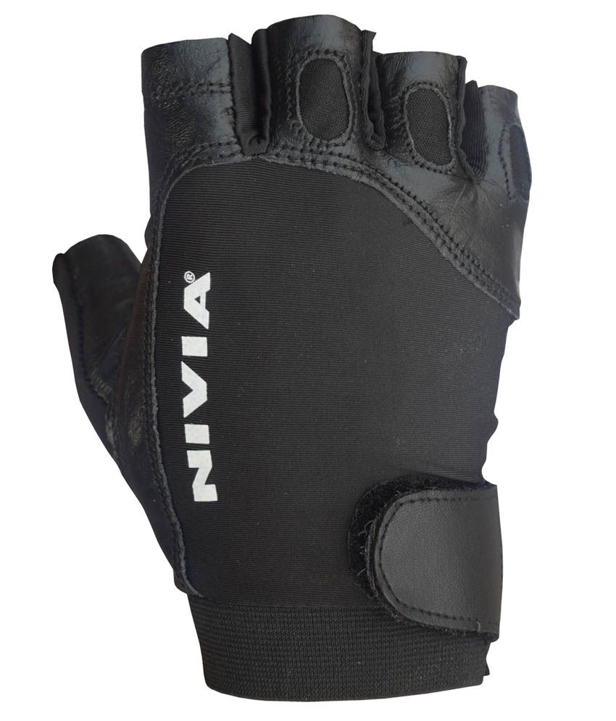
Nano biosensor incorporated in Nivia gym gloves
Tracks the amount of fat burned at any point of time doing any kind of activity
Keep the gym goers motivated to lose weight
If you can't measure it, you can't improve it. - Peter Drucker

Slide 7
How it works
Nano technology- Manipulating molecules at nano level
Highly sensitive-PPB range
Nano bio sensor-analyses components in molecular level with high precision
Low cost and compact

Slide 8
MARKET POTENTIAL &PRODUCT DIFFERENTIATION
Sensbit monitors the actual amount of fat burned
Biosensor-not an activity tracker
Accurate-no indirect calorie count
Idle fat burning rate
NTT-Docomo-commercial sensors-not practical
Research from other universities
TomTom- Bio impedance analysis
Low cost materials

Slide 9


Team
Advisor
Founder
Professor Karuna Kar Nanda Materials Research Centre, Indian Institute of Science(IISc), Bangalore
Krishnan M
M.Tech in Medical Nanotechnology

Slide 10
Thank you

